Slide 1
Predicting User Gifting Behaviour in KuaiShou (快手) Livestreams
Machine Learning Engineering
Anmol Malik
Gabriel Manuel Sidik
Goh Yun Si
Lee Sae Lin
Zexel Nicholas Lew
Notes:
Hi everyone, we are Group 3 and we will presenting our end-to-end ML pipeline for predicting gifting behaviour in livestreams.

Slide 2
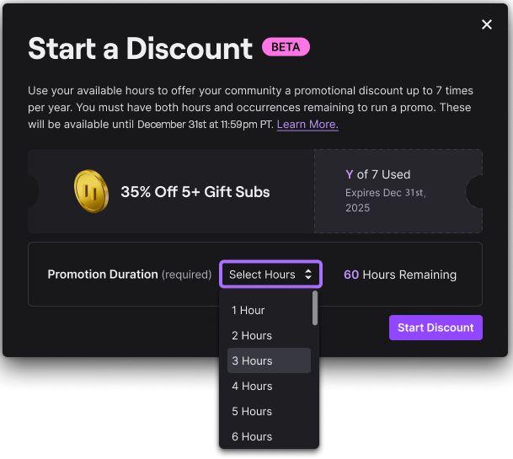
Background
2. Datasets
2.1 KuaiLive
KuaiLive [1] serves as the anchor dataset for model training. It is a structured CSV-based dataset collected from Kuaishou over a 21-day period (May 5 to May 25, 2025). It contains KuaiShou’s interaction logs of 23772 users, 452621 streamers, and over 5 million interactions (click, comment, like, gift). The dataset provides timestamped user interactions including gift records, user metadata such as gender and age, as well as room-level information like livestream category. These features allow us to reconstruct time-aware features for real-time inference.
[Brief EDA]
2.2 OmniBehaviour
OmniBehavior [2] is used as an auxiliary dataset to simulate pilot-testing of the model near real-time on a small sample of users. It is a JSON-based dataset collected over a longer horizon (September 1 to November 30, 2025). It describes the behavioural traces of 200 representative users spanning 5 scenarios (video browsing, e-commerce, advertisement, customer service, search behaviour, and livestreaming), 22 action types, with an average of over 8,000 actions per user. Only the livestreaming scenario is used for this project. 3. Design Considerations
One key challenge in our pipeline is schema adaptation to integrate two heterogeneous datasets that differ in both structure and user populations. In addition, the seasonal nature of live streaming behaviour necessitates temporal feature engineering to capture user engagement cycles (e.g. weekends, annual festivals). The near real-time prediction system must also satisfy two operational requirements: (1) low-latency inference to enable timely interventions before user disengagement, and (2) continuous monitoring and retraining to maintain model freshness under evolving datasets and user behaviour driven by seasonality, livestream content dynamics, and shifting user preferences.
A revenue engine resting on the top 1% of users
Kuaishou is a major Chinese short-video and live-streaming app - Douyin/TikTok’s main domestic competitor.
Live streaming = ~30% of its annual revenue; gift value is 50% co-shared with streamers.
238
users (top 1%) drive ~60% of all gift value
50%
of gifters gift only once every 21 days
OUR OBJECTIVE
Offer targeted discount bundles to persuadable viewers, to improve overall gifting revenue.
OUR TASK
Management wants to pilot a prediction model for 200 high-activity users. The datasets available are of vastly different formats (csv vs json).
Due to possible drifts between historical and present data, we would expect:
(1) that raw features will differ between the static and the actual pilot data
(2) the focus on users would mean that we should engineer features around relative user-behaviours.
Twitch does this. Kuaishou doesn’t.
Binary Classification
Notes:
So, just as a recap, this project aims to build a binary classification model for Kuaishou to increase overall gifting revenue, by possibly using this model to offer discounts to some viewers.
The problem statement is that our management team wants us to predict the gifting behaviour for 200 users. The catch is that there are 2 sets of data, historical and present, which are not only from different time frames but of vastly different formats as well.
We need to find a way to not only integrate the 2 very distinct dataset formats, but also account for possible drifts, including data drift and concept drift.

Slide 3



Architecture Overview
LEGEND
→ Batches (Training + EOD Rolling updates)
→ Real-Time Feature Flow
→ Real-Time Predictions
→ Monitoring
sETL Streaming ETL (Do minimal processing)
DAG 1: Training
Bronze
Silver
Gold
Promote / Rollback
ml_train.py
user
user
user
label
KuaiLive
ETL
ETL
ETL
model
bank
Canary Deployment
room
room
room
static
feature
like, gift,
comment
like, gift,
comment
Manual Review & Retrain
like, gift,
comment
ml_predict.py
rolling
feature
prediction
DAG 2: Feature Update
ETL
ml_monitor.py
sETL
user
prediction
sETL
sETL
event
event
metric
Inference
Dashboard
Realtime
OmniBehaviour
Simulation
raw
event
sETL
sETL
realtime
feature
redis
Notes:
So I will share a brief overview on our architecture.
First, you’ll notice that we built 2 DAGs and a real-time inference pipeline.
The 1st DAG is for training on the historical KuaiLive data.
After that, when we deploy our model, we will follow the real-time inference pipeline for model predictions.
And the 2nd DAG, is that at the end of the day, we need to perform some feature updates, which is especially key to update the rolling features for the next day.

Slide 4
Deployment & Metrics
Deployment Strategy: Canary Model | Performance Metrics |  | Stability Metrics
 | P0 (PR-AUC Lift) | P1 (ROC-AUC) | PSI | CSI
Green Zone | ≥ 3.0× | ≥ 0.70 | < 0.10 | ≥ 0.25 for < 30% cols
Yellow Zone (daily + 7-day rolling) | 1.5× – 3.0× | 0.60 – 0.70 | 0.10 – 0.25 | ≥ 0.25 for 30% – 50% cols
Red Zone (7-day rolling only) | < 1.5× | < 0.60 | ≥ 0.25 | ≥ 0.25 for ≥ 50% cols
REVIEW & RETRAIN CRITERIA
Review & retrain when any of the metrics hit red zone:
P0 (PR-AUC Lift) or P1 (ROC-AUC) hits Red Zone
PSI hits Red Zone — after ruling out a data pipeline issue
CSI hits Red Zone — after ruling out a data pipeline issue
RETRAIN & DEPLOY LOGIC
Retrain a model based on recent (past 20 to 30 days) data.
Try 2 candidate models - XGBoost and LightGBM.
The better candidates when comparing P0 will be deployed.
Deploy the winning candidate via canary — promote if it outperforms the current production model on P0
Notes:
We will use the Canary model as a deployment method.
Our p0 target is for PR-AUC lift, given that are target variable is extremely skewed, with a 1% gifting rate across all user-stream combinations.
We will also monitor for ROC-AUC and other feature stability metrics.
And here we define some criteria and guidelines to retrain the model. This is primarily if if we fall into any of the red zones and we can pinpoint the cause of the drift.
Now I will let Gabriel take you through the feature engineering segment.

Slide 5




Feature Engineering - Overview
2 Raw Sources
Integrating data from Kuailive & Omni
Real-Time Prediction
As-of snapshots to
prevent data leakage
for live propensity scoring
Features Update
Different feature families have variable update frequencies

Slide 6





FeatEng - Data Harmonization
Kualive
Silver Store
Watch, Comment, Gift, …
Harmonized Projection
Transforming diverse raw schemas into a unified temporal view
Point-in-Time As-of Join
Single Source of Truth
feature_columns.py
Final Point-in-Time Feature Vectors
Validated Omni Eventstore/
Eventstream

Slide 7
FeatEng - Feature Vector Generation
User Static Information: age = 27, gender = F
User Historical Information: gift_rate = 0.04 ← Updated daily!
# | event_ts | action
1 | 10:00:00 | ENTER
2 | 10:00:08 | LIKE
3 | 10:00:19 | LIKE
4 | 10:00:25 | COMMENT
5 | 10:00:59 | LIKE
6 | 10:01:10 | GIFT
7 | 10:01:35 | LIKE
8 | 10:02:00 | COMMENT
emit_ts | age | G | gift_rate | likes | has_cmnt | last_event | Label
10:00:00 | 27 | M | 0.04 | 0 | F | ENTER | True
10:00:08 | 27 | M | 0.04 | 1 | F | LIKE | True
10:00:38 | 27 | M | 0.04 | 2 | T | COMMENT | True
10:00:59 | 27 | M | 0.04 | 3 | T | LIKE | True
30sec
Event Emitted at entry time (user baseline)
1st Event
30s delay after 1st Event (if high velocity)
All events including and after 1st gift do not generate feature vectors
Label (unknown for real time prediction)

Slide 8
Model Results
KuaiLive Model Performance
Omni Model Performance
Split | N | PR -AUC | Lift | ROC
TRAIN | 2.8M | 0.4487 | 6599 | 0.999
VAL | 815k | .3751 | 5460 | 0.9684
TEST | 407k | .2958 | 4305 | 0.9557
OOT | 896k | .0737 | 971 | 0.9329
Split | N | PR -AUC | Lift | ROC
TRAIN | 902k | 0.8928 | 91.072 | 0.9983
VAL | 257k | 0.8891 | 90.69 | 0.9982
TEST | 128k | 0.8956 | 91.317 | 0.9981
OOT | 126k | 0.0976 | 7.817 | 0.6707
Key Finding: KuaiLive maintains strong OOT lift (147x) while Omni model collapses (0.8x)

Slide 9
Architecture Overview
LEGEND
→ Batches (Training + EOD Rolling updates)
→ Real-Time Feature Flow
→ Real-Time Predictions
→ Monitoring
sETL Streaming ETL (Do minimal processing)
DAG 1: Training
Bronze
Silver
Gold
Promote / Rollback
ml_train.py
user
user
user
label
KuaiLive
ETL
ETL
ETL
model
bank
Canary Deployment
room
room
room
static
feature
like, gift,
comment
like, gift,
comment
Manual Review & Retrain
like, gift,
comment
ml_predict.py
rolling
feature
prediction
DAG 2: Feature Update
ETL
ml_monitor.py
sETL
user
prediction
sETL
sETL
event
event
metric
Inference
Dashboard
Realtime
OmniBehaviour
Simulation
raw
event
sETL
sETL
realtime
feature
redis
Notes:
So I will share a brief overview on our architecture.
First, you’ll notice that we built 2 DAGs and a real-time inference pipeline.
The 1st DAG is for training on the historical KuaiLive data.
After that, when we deploy our model, we will follow the real-time inference pipeline for model predictions.
And the 2nd DAG, is that at the end of the day, we need to perform some feature updates, which is especially key to update the rolling features for the next day.

Slide 10

Model Pipeline & Training
→ Batches
→ Real-Time Feature Flow
→ Real-Time Predictions
→ Monitoring
Bronze
Silver
Gold
ml_train.py
user
user
user
label
KuaiLive
ETL
ETL
ETL
model
bank
room
room
room
static
feature
like, gift,
comment
like, gift,
comment
like, gift,
comment
ml_predict.py
rolling
feature
prediction
metric
Notes:
DAG 1 is the starting point. It runs once - a single pipeline that takes our full historical KuaiLive dataset and turns it into a trained model sitting in the model bank.
As Zexel explained about our medallion architecture, it moves through three ETL stages and then trains the model. After training, we run an OOT evaluation: we generate predictions and check performance on five held-out dates, May 21 to 25, 2025, which the model never saw during training. This tells us whether the model generalises before we use it in production.
The output of DAG 1 is a single file: a .pkl model in the model bank. The rest of the system is built on that file.
XGBoost was chosen for this project due to its inference speed, robustness to outliers, built-in regularization to mitigate overfitting, and feature importance outputs for interpretability. Two models were trained for this project (refer to Section X). As a non-parametric tree-based method, it effectively models complex relationships in large-scale tabular datasets (~3 million samples for Model 1, and ~1 million samples for Model 2).
Hyperparameters are tuned with RandomizedSearchCV over the validation set. The parameter space and tuned hyperparameters are shown in Table 1. Class imbalance is handled with scale_pos_weight set to the train positive rate. To improve probability calibration, Platt scaling (sigmoid calibration) was applied by fitting a logistic regression model to the validation-set predictions. Test and OOT set remain clean holdouts. Gain-based feature importance is recorded for interpretability.

Slide 11
Live Flow & Monitoring
→ Batches
→ Real-Time Feature Flow
→ Real-Time Predictions
→ Monitoring
sETL Streaming ETL
Bronze
Silver
Gold
Promote / Rollback
ml_train.py
user
user
label
ETL
ETL
model
bank
Canary Deployment
room
room
static
feature
like, gift,
comment
Manual Review & Retrain
like, gift,
comment
ml_predict.py
rolling
feature
prediction
ETL
ml_monitor.py
sETL
user
prediction
sETL
sETL
event
event
metric
Dashboard
Realtime
OmniBehaviour
Simulation
raw
event
sETL
sETL
realtime
feature
redis

Slide 12
Historical Feature Updates
→ Batches
→ Real-Time Feature Flow
sETL Streaming ETL
Bronze
Silver
Gold
user
user
label
ETL
ETL
room
room
static
feature
like, gift,
comment
like, gift,
comment
rolling
feature
ETL
sETL
user
prediction
event
event
metric
Realtime
OmniBehaviour
Simulation
raw
event
realtime
feature
Notes:
Batch plane: ml_train → model_bank; ml_monitor → drift? → retrain → promote → new model_bank
resolve_active_model
│
etl_bronze ← reads NDJSON event tape files from disk (not Kafka)
│
[bronze_user, bronze_room, bronze_like, bronze_gift, bronze_comment]
│
etl_silver
│
[silver_user, silver_room, silver_like, silver_gift, silver_comment]
│
etl_gold ← 30-day rolling window, --inference mode
│
[gold_feature_static, gold_feature_rolling, gold_feature_realtime] + gold_label
│ │
ml_predict ──────────────────────────────────────────────────────── (joined)
│
gold_pred + gold_label
│
ml_monitor
│
manual_review
│
manual_retrain ← only executes on 2025-09-20
│
canary_deployment
│
[promote_model / rollback_model]
Scheduled nightly, with catchup from Sep 1 → Dec 2, 2025
Purpose: Daily production inference pipeline with model governance — predicts gifts, monitors drift, and includes a one-time retrain + promotion flow on Sep 20, 2025.
DAG 2 handles the day-to-day operation. It runs every night at 11:59 PM, from September 1st through December 2nd. Catchup is enabled, so every day in that window gets processed even if the scheduler was down.
One thing worth pointing out: DAG 2 doesn't start with a fixed model. The first task — resolve_active_model — decides at runtime which model to use for that day's run. Before September 21st, it uses the KuaiLive model from DAG 1. From September 21st onward, it switches to the new Omni model. That choice is passed downstream through Airflow's XCom, so both the prediction and monitoring steps use the right model without anyone stepping in.
The pipeline runs daily inference, and then comes the governance step. On September 20th specifically, a retrain runs on Omni data collected since September 1st. The new model goes through canary deployment, and the team makes a deliberate promote-or-rollback decision. That's why September 21st is the promotion date — it's a planned handover, not an automatic swap.
depends_on_past=True means each day's run has to succeed before the next one starts — which keeps the feature store and predictions consistent and stops a failed day from affecting the next one.
Key Talking Points:
Nightly schedule with catchup (59 23 * * *, catchup=True, max_active_runs=1) — processes every day in the Sep 1–Dec 2 window sequentially, one run at a time
Dynamic model selection via resolve_active_model — XCom passes the model name to both ml_predict and ml_monitor; the cutover on Sep 21 is automatic based on run date, not a config change
depends_on_past=True — enforces sequential daily runs; a failed day blocks the next, preserving data consistency
One-time retrain is embedded in the DAG — manual_retrain runs only when ds == 2025-09-20, skips all other days with an explicit log message; the training window is fixed at Sep 1–20
Governance is explicit — manual_review → manual_retrain → canary_deployment → promote_model / rollback_model is a deliberate human-in-the-loop pattern, not fully automated; the team retains control over promotion

Slide 13
Real-time Model Inference (Kafka)
→ Batches
→ Real-Time Feature Flow
→ Real-Time Predictions
→ Monitoring
sETL Streaming ETL
Bronze
Silver
Gold
user
user
label
model
bank
room
room
static
feature
like, gift,
comment
like, gift,
comment
ml_predict.py
rolling
feature
prediction
user
ml_monitor.py
sETL
prediction
sETL
sETL
event
event
metric
Dashboard
Realtime
OmniBehaviour
Simulation
raw
event
sETL
sETL
realtime
feature
redis
Notes:
Batch plane: ml_train → model_bank; ml_monitor → drift? → retrain → promote → new model_bank
resolve_active_model
│
etl_bronze ← reads NDJSON event tape files from disk (not Kafka)
│
[bronze_user, bronze_room, bronze_like, bronze_gift, bronze_comment]
│
etl_silver
│
[silver_user, silver_room, silver_like, silver_gift, silver_comment]
│
etl_gold ← 30-day rolling window, --inference mode
│
[gold_feature_static, gold_feature_rolling, gold_feature_realtime] + gold_label
│ │
ml_predict ──────────────────────────────────────────────────────── (joined)
│
gold_pred + gold_label
│
ml_monitor
│
manual_review
│
manual_retrain ← only executes on 2025-09-20
│
canary_deployment
│
[promote_model / rollback_model]
Scheduled nightly, with catchup from Sep 1 → Dec 2, 2025
Purpose: Daily production inference pipeline with model governance — predicts gifts, monitors drift, and includes a one-time retrain + promotion flow on Sep 20, 2025.
DAG 2 handles the day-to-day operation. It runs every night at 11:59 PM, from September 1st through December 2nd. Catchup is enabled, so every day in that window gets processed even if the scheduler was down.
One thing worth pointing out: DAG 2 doesn't start with a fixed model. The first task — resolve_active_model — decides at runtime which model to use for that day's run. Before September 21st, it uses the KuaiLive model from DAG 1. From September 21st onward, it switches to the new Omni model. That choice is passed downstream through Airflow's XCom, so both the prediction and monitoring steps use the right model without anyone stepping in.
The pipeline runs daily inference, and then comes the governance step. On September 20th specifically, a retrain runs on Omni data collected since September 1st. The new model goes through canary deployment, and the team makes a deliberate promote-or-rollback decision. That's why September 21st is the promotion date — it's a planned handover, not an automatic swap.
depends_on_past=True means each day's run has to succeed before the next one starts — which keeps the feature store and predictions consistent and stops a failed day from affecting the next one.
Key Talking Points:
Nightly schedule with catchup (59 23 * * *, catchup=True, max_active_runs=1) — processes every day in the Sep 1–Dec 2 window sequentially, one run at a time
Dynamic model selection via resolve_active_model — XCom passes the model name to both ml_predict and ml_monitor; the cutover on Sep 21 is automatic based on run date, not a config change
depends_on_past=True — enforces sequential daily runs; a failed day blocks the next, preserving data consistency
One-time retrain is embedded in the DAG — manual_retrain runs only when ds == 2025-09-20, skips all other days with an explicit log message; the training window is fixed at Sep 1–20
Governance is explicit — manual_review → manual_retrain → canary_deployment → promote_model / rollback_model is a deliberate human-in-the-loop pattern, not fully automated; the team retains control over promotion

Slide 14
Real-time Model Inference (Kafka)
→ Batches
→ Real-Time Feature Flow
→ Real-Time Predictions
→ Monitoring
sETL Streaming ETL
Bronze
Silver
Gold
user
user
label
model
bank
room
room
static
feature
like, gift,
comment
like, gift,
comment
ml_predict.py
rolling
feature
prediction
user
ml_monitor.py
sETL
ETL
prediction
event
metric
Dashboard
Realtime
OmniBehaviour
Simulation
sETL
sETL
raw
event
validated
event
realtime
feature
redis
Notes:
Batch plane: ml_train → model_bank; ml_monitor → drift? → retrain → promote → new model_bank
resolve_active_model
│
etl_bronze ← reads NDJSON event tape files from disk (not Kafka)
│
[bronze_user, bronze_room, bronze_like, bronze_gift, bronze_comment]
│
etl_silver
│
[silver_user, silver_room, silver_like, silver_gift, silver_comment]
│
etl_gold ← 30-day rolling window, --inference mode
│
[gold_feature_static, gold_feature_rolling, gold_feature_realtime] + gold_label
│ │
ml_predict ──────────────────────────────────────────────────────── (joined)
│
gold_pred + gold_label
│
ml_monitor
│
manual_review
│
manual_retrain ← only executes on 2025-09-20
│
canary_deployment
│
[promote_model / rollback_model]
Scheduled nightly, with catchup from Sep 1 → Dec 2, 2025
Purpose: Daily production inference pipeline with model governance — predicts gifts, monitors drift, and includes a one-time retrain + promotion flow on Sep 20, 2025.
DAG 2 handles the day-to-day operation. It runs every night at 11:59 PM, from September 1st through December 2nd. Catchup is enabled, so every day in that window gets processed even if the scheduler was down.
One thing worth pointing out: DAG 2 doesn't start with a fixed model. The first task — resolve_active_model — decides at runtime which model to use for that day's run. Before September 21st, it uses the KuaiLive model from DAG 1. From September 21st onward, it switches to the new Omni model. That choice is passed downstream through Airflow's XCom, so both the prediction and monitoring steps use the right model without anyone stepping in.
The pipeline runs daily inference, and then comes the governance step. On September 20th specifically, a retrain runs on Omni data collected since September 1st. The new model goes through canary deployment, and the team makes a deliberate promote-or-rollback decision. That's why September 21st is the promotion date — it's a planned handover, not an automatic swap.
depends_on_past=True means each day's run has to succeed before the next one starts — which keeps the feature store and predictions consistent and stops a failed day from affecting the next one.
Key Talking Points:
Nightly schedule with catchup (59 23 * * *, catchup=True, max_active_runs=1) — processes every day in the Sep 1–Dec 2 window sequentially, one run at a time
Dynamic model selection via resolve_active_model — XCom passes the model name to both ml_predict and ml_monitor; the cutover on Sep 21 is automatic based on run date, not a config change
depends_on_past=True — enforces sequential daily runs; a failed day blocks the next, preserving data consistency
One-time retrain is embedded in the DAG — manual_retrain runs only when ds == 2025-09-20, skips all other days with an explicit log message; the training window is fixed at Sep 1–20
Governance is explicit — manual_review → manual_retrain → canary_deployment → promote_model / rollback_model is a deliberate human-in-the-loop pattern, not fully automated; the team retains control over promotion

Slide 15
Monitoring Simulation
Stage | Dates | Phase | Expected Outcome
1 | May 5 to 25 | Training: train model 1 on historical dataset | Baseline performance
2 | Sep 1 to 20 | Drift: population changes in new dataset | Degraded performance
3 | Sep 20 | Retraining: train model 2 on new dataset | New baseline
4 | Sep 21 onwards | Deployment: switch to model 2 | Performance improvement
Performance metrics: PR-AUC Lift, ROC-AUC
Stability metrics: PSI, CSI
Other monitoring:
Volume monitoring for data quality tracing: gifters, viewers, streams
Bias monitoring for model fairness review: gender, age
Notes:
To test our model, we simulated 4 stages. We first train a model on historical data in May. By September, a new dataset comes in and data drift is expected to degrade performance. After collecting data for 20 days, we retrain a new model on September 20. From September 21 onward, we switch to the new model and hope that the performance recovers. Throughout these stages, we’ll monitor performance and stability. While not presented today, will also monitor volumes for easy tracing of data drift issues, and monitor bias in different demographic groups to ensure model fairness.

Slide 16
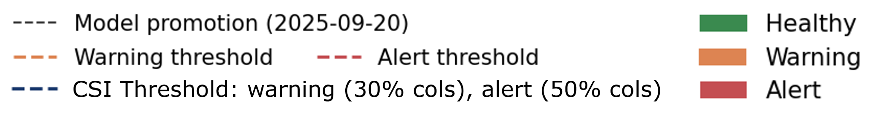
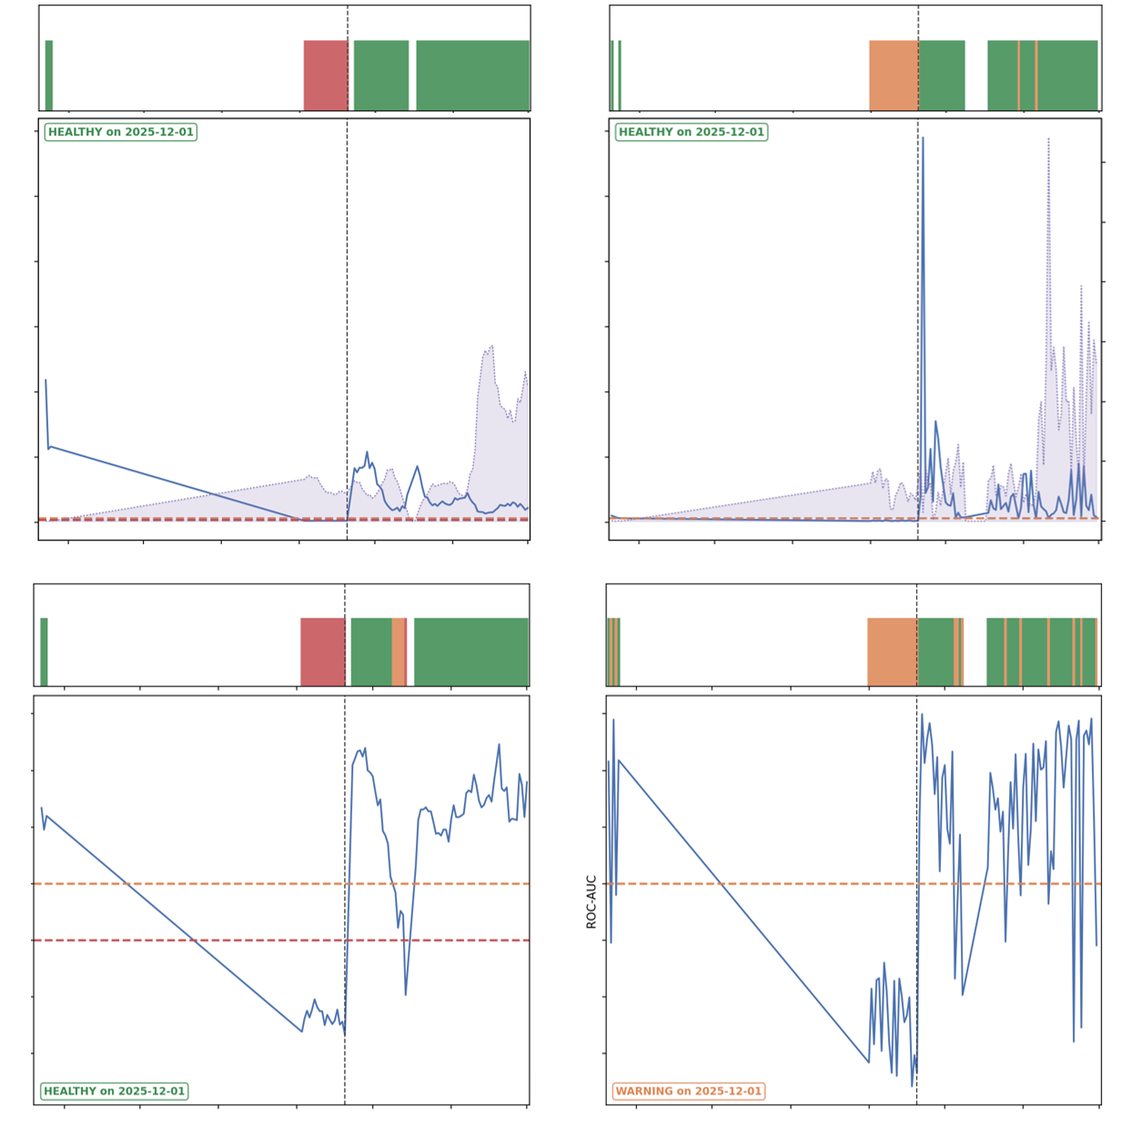
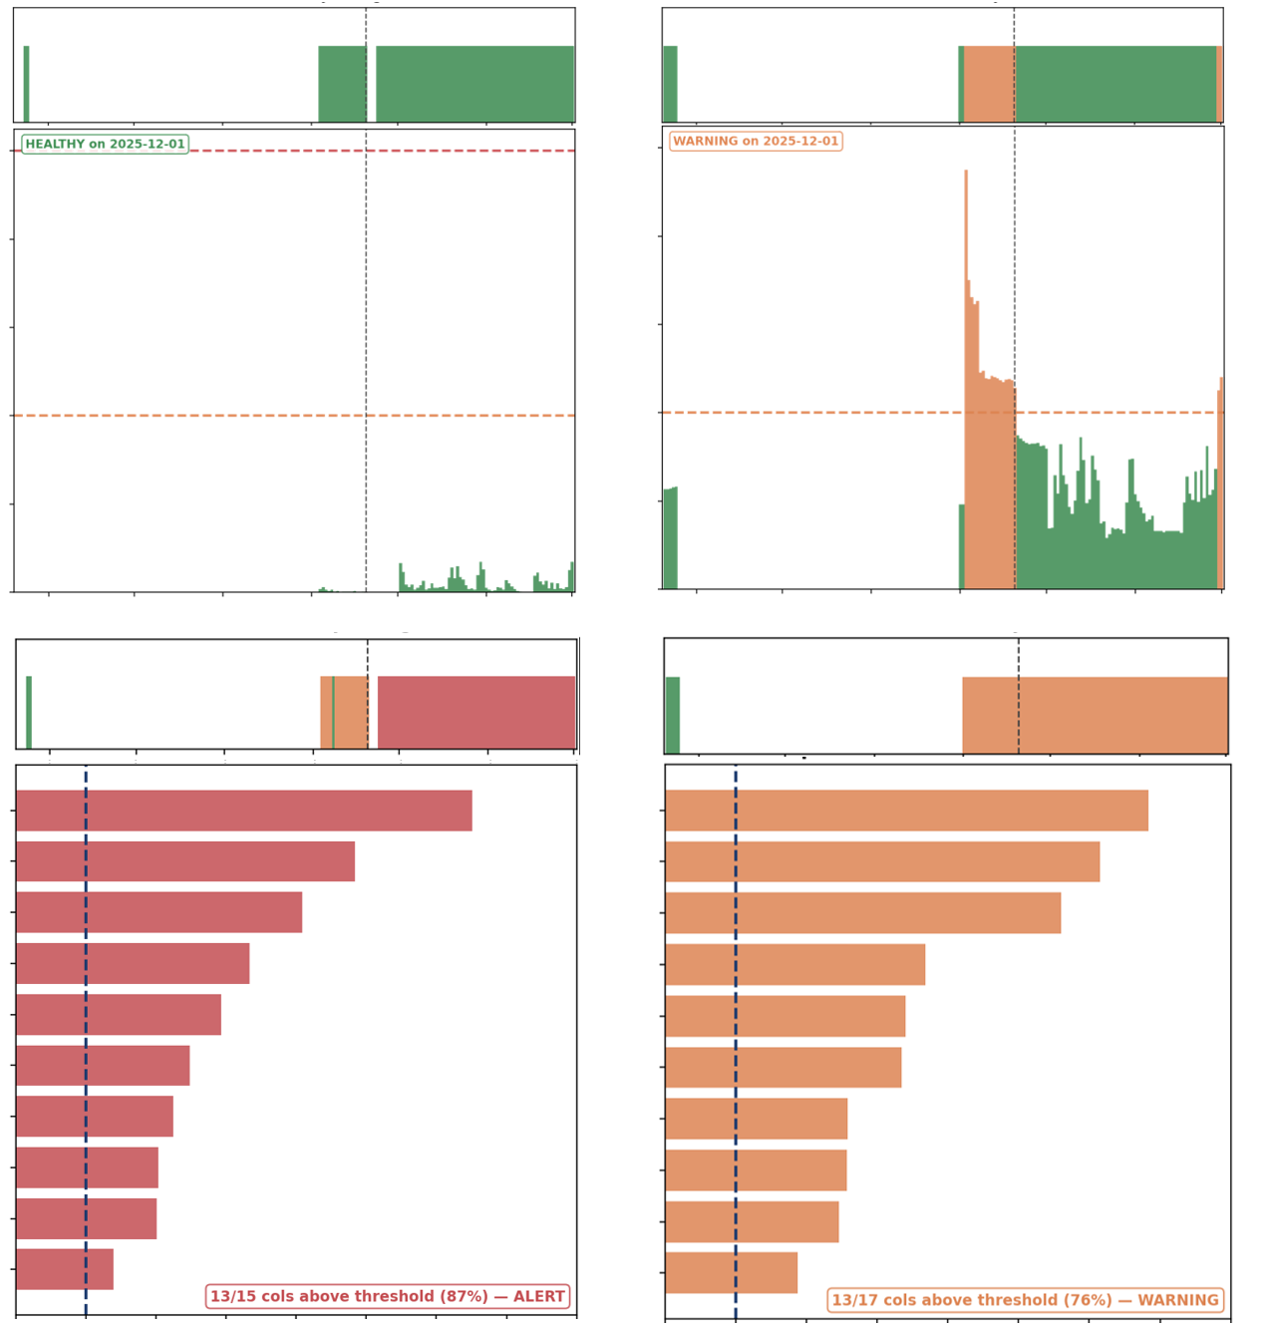
Main Monitoring Results
LEGEND
Performance
Stability
7-Day Rolling
Daily
7-Day Rolling
Daily
300
0.25
0.12
P0: PR-AUC Lift
Positive Rate
PSI
0.00
0
0.00
May
Dec
May
Dec
1.0
4
1
Top 10 CSI Features
P1: ROC-AUC
2
0.4
Golden Week
May
Dec
May
Dec
0.00
2.00
0.00
2.00
Time
Time
CSI
CSI
Notes:
There’s a lot of information here, but most of the metrics tell the same story. Let’s focus on the bottom-left plot showing AUC, which everyone is familiar with. In Stage 1, when the first model is deployed, we can see that the model performs reasonably well. But when the new dataset comes in during Stage 2, performance drops significantly and triggers alerts. After retraining and promoting a new model on September 20, performance improves again in Stage 4.
You'll also notice a performance drop during Golden Week. During that period, live streaming and gifting was almost non-existent, which affected the model’s performance. However, this was temporary and only generated warning signals under our governance workflow.
For stability monitoring on the right, PSI remains relatively healthy throughout, except during the cross-domain period. CSI, on the other hand, sends daily warnings. As it remains healthy when evaluated over a rolling 7-day window and model performance is acceptable, the live-streaming features may simply be highly variable, and we might want to lower the thresholds.

Slide 17
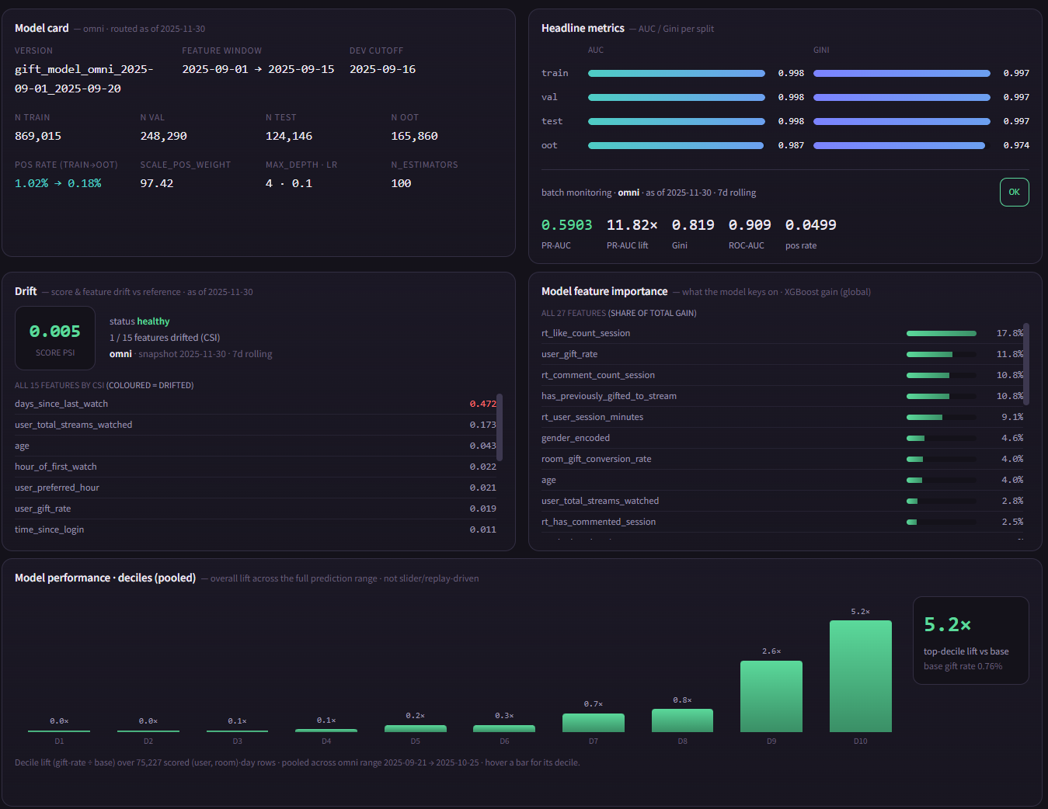
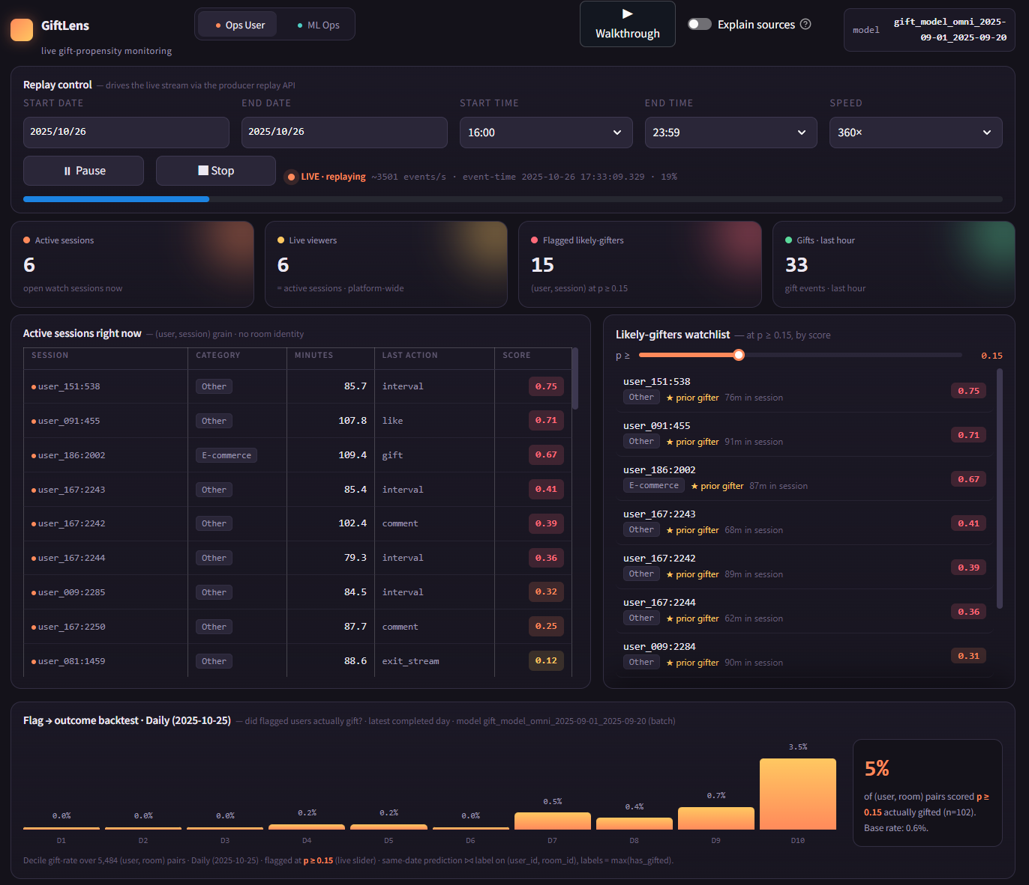
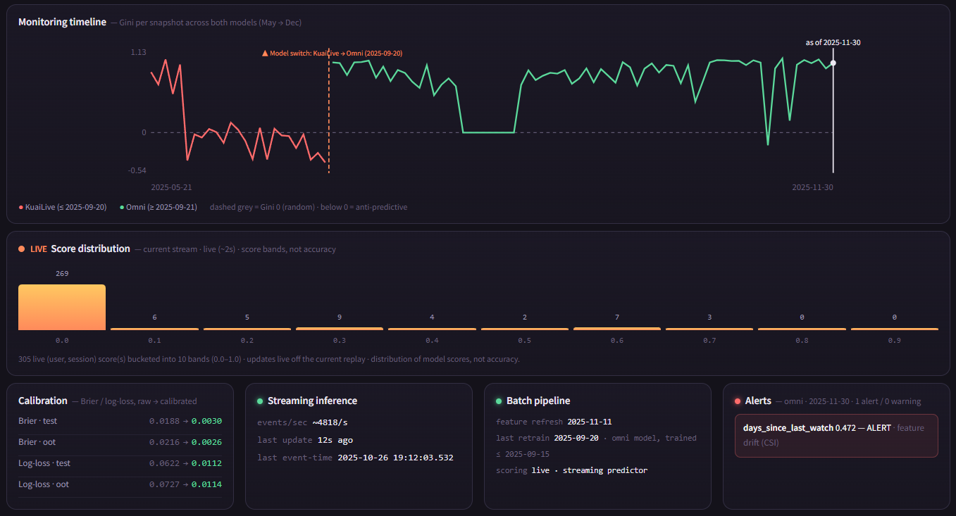
Dashboard

